Slide 1

Running Man
Homeowner’s Association Meeting
1 December 2025
Tabb Elementary School Cafeteria
7:00PM

Slide 2
AGENDA
President’s Welcome Eric Todhunter
York County District 5 Representative Comments Tom Shepperd
President’s Report Eric Todhunter
  Status of Governing Document
  Status of Volunteerism
Treasurer’s Report Eric Todhunter
Webmaster Report Liz Rooney
Neighborhood Watch David Glover
Architecture Control Report Sam Huffstetler
Covenants Report Ritendra Bhattacharya
Landscape / Common Area Report Matt Matson
CY2025 Accomplishments Overview Eric Todhunter
Election of Officers for 2026 Board Eric Todhunter

Slide 3
York County Representative
Tom Shepperd
District 5 Representative
York County Board of Supervisors
shepperd@yorkcounty.gov
(757)903-1875

Slide 4
PRESIDENT’S REPORT
Eric Todhunter
President

Slide 5
Running Man Community Association
Vision Statement
Have a neighborhood that is engaging, family friendly, and aesthetically pleasing while sustaining a modest annual cost to our neighbors
Strategic Objective
Sustain or improve current community assets and add to the amenities available to the neighborhood as funding permits

Slide 6
Covenants Consolidation
Recap
Initial work began in February 2020 by the Covenant Consolidation Committee consisting of ; Kathy Cook, Kathey Tapfer, Huck Robinson, and Dick Strunk.
  Crafted initial consolidation of covenants into a format provided by RM’s legal advisors
  Passed product off to HOA Board April 2020
Board quickly realized the Covenants and the By-Laws were inter-dependent requiring both to be updated- -effort evolved into an update of all governing documents.
Board took a holistic view of the Running Man governing documents; covenants, By-Laws, and ACC Standards (formerly ACC Guidelines).
Board focused on formatting, organizing the documents, and covering new topics that were not envisioned when the developers began construction of our neighborhood 35 years ago
Board working closely with the legal firm of Gordon, Rees, Scully, and Mansukhani for:
  legal review to ensure everything is still legally sufficient
  Add language to facilitate the RM HOA to annex or acquire assets that facilitates the maintenance of neighborhood property values.
In 2021 the Board began work on update of the Articles of Incorporation as well.
No action taken since July 2024

Slide 7
ELECTION OF OFFICERS
Current Nominees
Nominations from the Neighborhood – If you’re interested in joining the CY2026 RM HOA Board please let us know.
Vote
Ritendra Bhattacharya
David Glover
Sam Huffsteler
Russell Kratoville
Matt Matson
Liz Rooney
Eric Todhunter
Noel West
Entire Current Board Volunteering to Return to serve another year!

Slide 8
Running Man Community Association
Volunteer Opportunities
You can still serve the community in other capacities without being on the HOA Board.
ACC Committee Member
Luminaries Coordinator
Neighborhood Garage Sale Coordinator
Neighborhood Welcome Coordinator
Project Officer supporting the Landscape/Common Area Director

Slide 9
TREASURER’S REPORT
RUSSELL KRATOVILLE
Treasurer

Slide 10
TREASURER’S REPORT
2025 Budget Status
Page 1 of 2

Slide 11
TREASURER’S REPORT
2025 Budget Status
ASSETS
CHECKING: $ 25,477.32
SAVINGS: $ 25.00
MM (Res) $124,513.58 CD (Savings) $ 81,199.12
$231,215.02
Page 2 of 2

Slide 12
TREASURER’S REPORT
2026 Budget
2026 BUDGET
INCOME
Architectural Fees $750.00
Disclosure Packets $1,000.00
Dues (589X$231.00) $136,059.00
Verizon Tower $11,000.00
DISH Network $ 8,600.00
Reserve $95,281.00
TOTAL INCOME $252,690.00
Page 1 of 2

Slide 13
TREASURER’S REPORT
2026 Budget
EXPENSES
2026 BUDGET
EXPENSES
2026 BUDGET
Admin- Stipend $ 1,800.00 Annual Meeting $750.00
Annual State Registration $155.00
Board Treasurer Supplies $350.00
Disclosure Pkg Costs $300.00
Stipend $800.00
Dues Letters- Cost $750.00
Stipend $883.50
Electricity $4,491.84
Garage Sale $400.00
Grounds Improvements $3,790.50
Grounds Maintenance $64,633.02
Insurance-Common Area $7,500.00
Legal Fees $11,500.00
Luminaries $3,200.00
Neighborhood Activities $3,200.00
Neighborhood Watch $ 300.00
Pond Maintenance $4981.63
PO Box Rental $ 186.00
Reserve
Fore Bay Cleaning $15,850.00
Playground Shelter. $50,000.00
Monument Refurbish. $40,000.00
Storage Unit $2,208.00
Taxes-Accountant Fees $ 875.00
-Federal $4,568.00
-State $1,017.00
Welcome Packets $ 100.00
Reserve Fund Contrib. $28,100.00
TOTAL EXPENSES $252,689.49
Page 2 of 2

Slide 14
TREASURER’S REPORT
2026 Annual Dues Letter
This letter is to inform you that the annual Running Man Community Association, Inc. (RMCA) assessment will increase for the 2025 calendar year to $ 231.00 per lot owned which reflects an increase of 5% in accordance with our Covenants and Bylaws. Annual assessment payments are due January 1st each year. Any assessment payment which is not paid within 30 days will be delinquent.
Your 2026 annual assessment payment should be submitted as follows:
Online Payment Option: Payments can be submitted via the Running Man website at http://www.runningmancommunity.org
Payment is due and payable by January 1, 2026, and will be considered delinquent if not received by January 31, 2026.
Make checks payable to RMCA in the amount of $ 231.00
Mail to: Running Man Community Association
P.O. Box 2114
Poquoson, VA 23662
Please Include your Running Man street address on the check to ensure proper credit to your account
All Payments: via online banking, personal check, cashier’s check, or money order must be postmarked by January 31, 2026 and be submitted for the 2025 annual assessment amount of $231.00 to be considered on time.
Failure to pay your assessment in full by the deadline may result in your account being turned over to our attorney for collections. The initial charge for the demand letter from our attorney will be $ 192.00, which amount will be added to your account. Such amounts are your responsibility under the governing documents of the Association. Legal fees and costs shall continue to accrue as additional collections efforts are taken until such amount is paid in full.
To avoid additional charges and / or collections actions, including, but not limited to, the filing of a memorandum of lien against your lot, please make your payment on time.
Note: The RMCA will not send multiple reminder letters.
Thank you in advance for your assistance.
RMCA Board

Slide 15
COMMUNICATIONS/ WEBMASTER
Liz Rooney
Director

Slide 16
COMMUNICATIONS/ WEBMASTER
Key Points
The Communications position is responsible for maintaining the Running Man Website and posting Neighborhood Watch alerts. These alerts are posted to the Running Man Nextdoor.com website
The Running Man website, runningmancommunity.com, was designed by RM resident Melissa James of Creative Copy. The website combines the RMCA, RMRA, and swim team information, making it easy to find exactly what you are looking for.

Slide 17
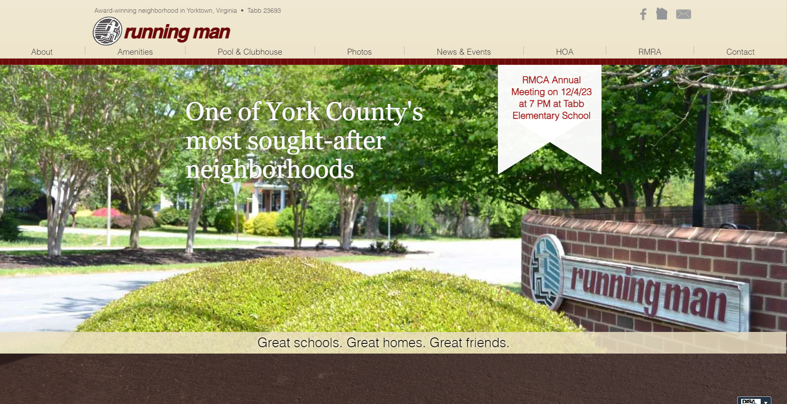
COMMUNICATIONS/ WEBMASTER
WEBSITE: https://www.runningmancommunity.org/
Contact Webmaster: runningmanhoa@gmail.com

Slide 18
David Glover
Neighborhood Watch

Slide 19
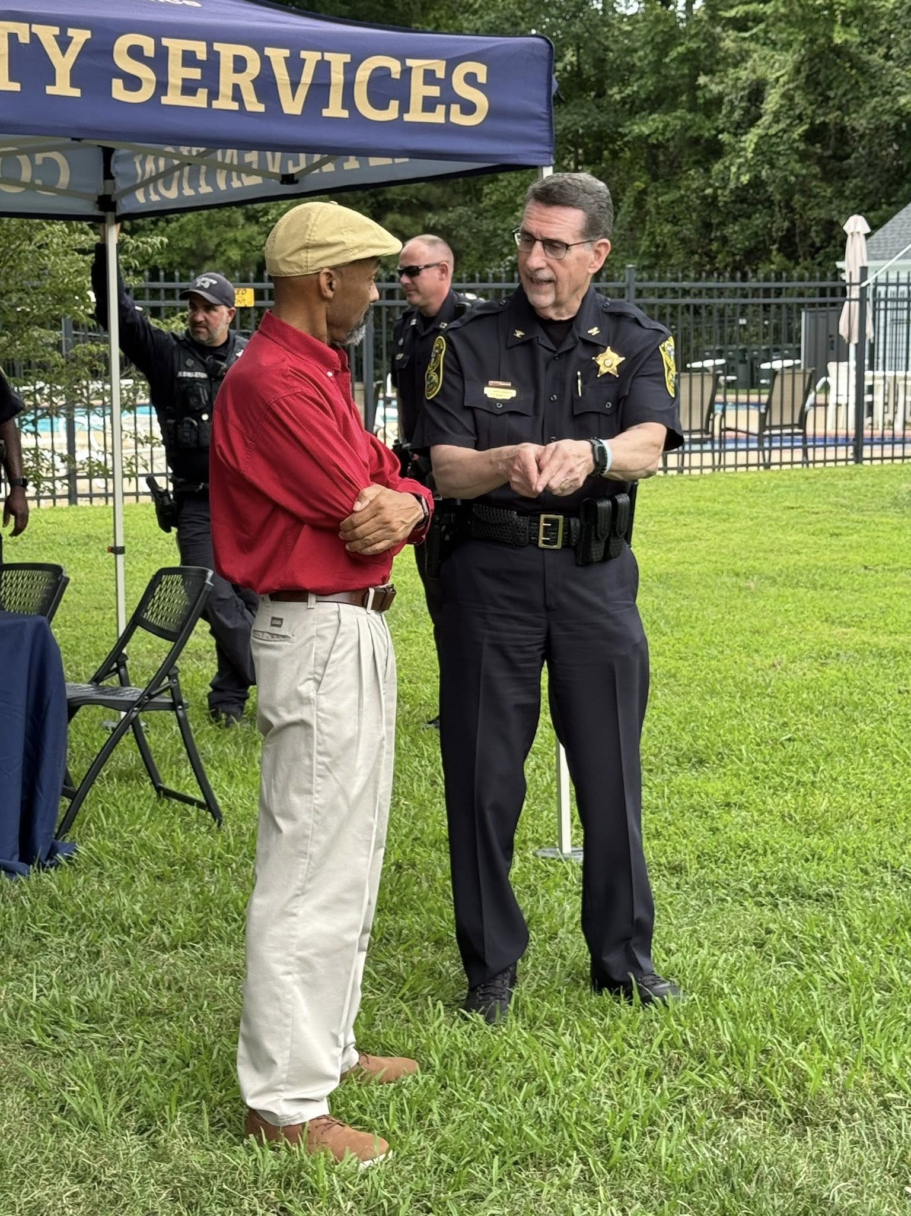
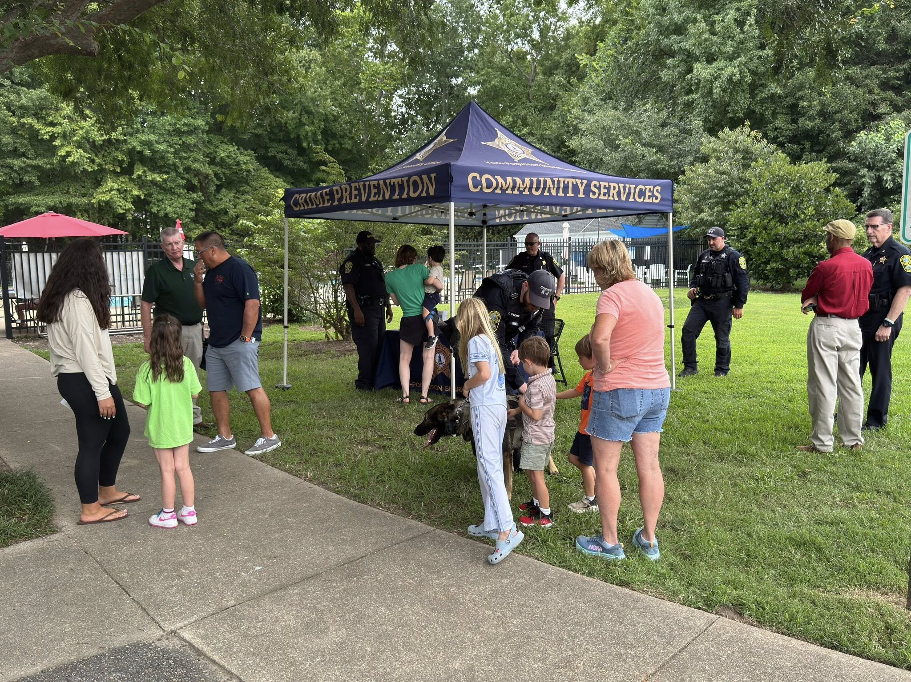
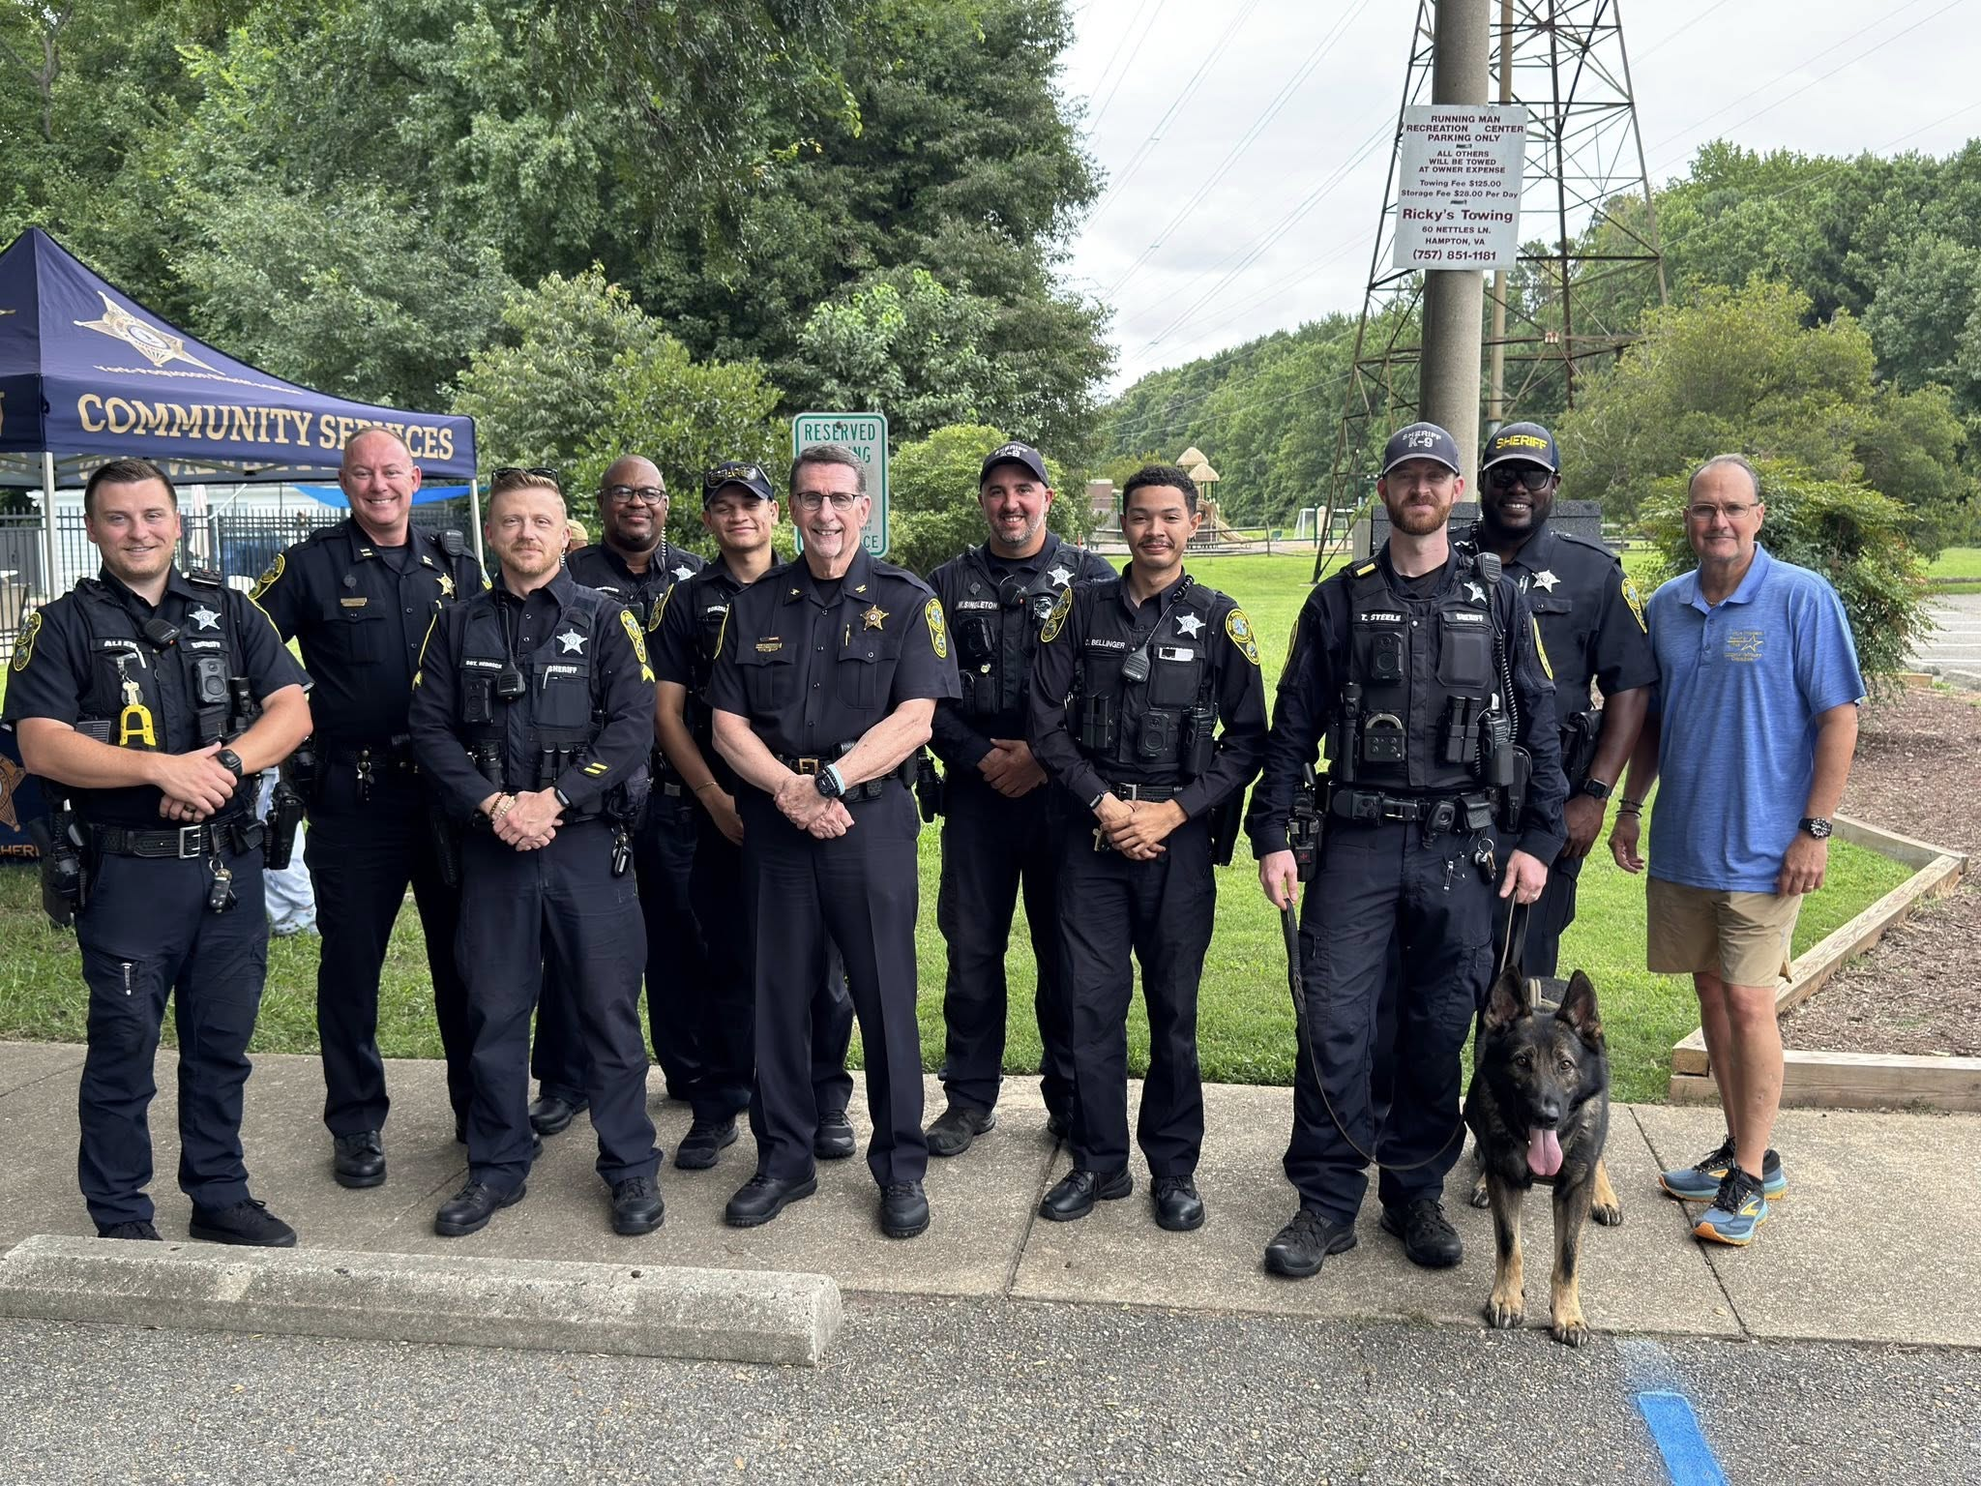
NATIONAL NIGHT OUT
August 5, 2025

Slide 20
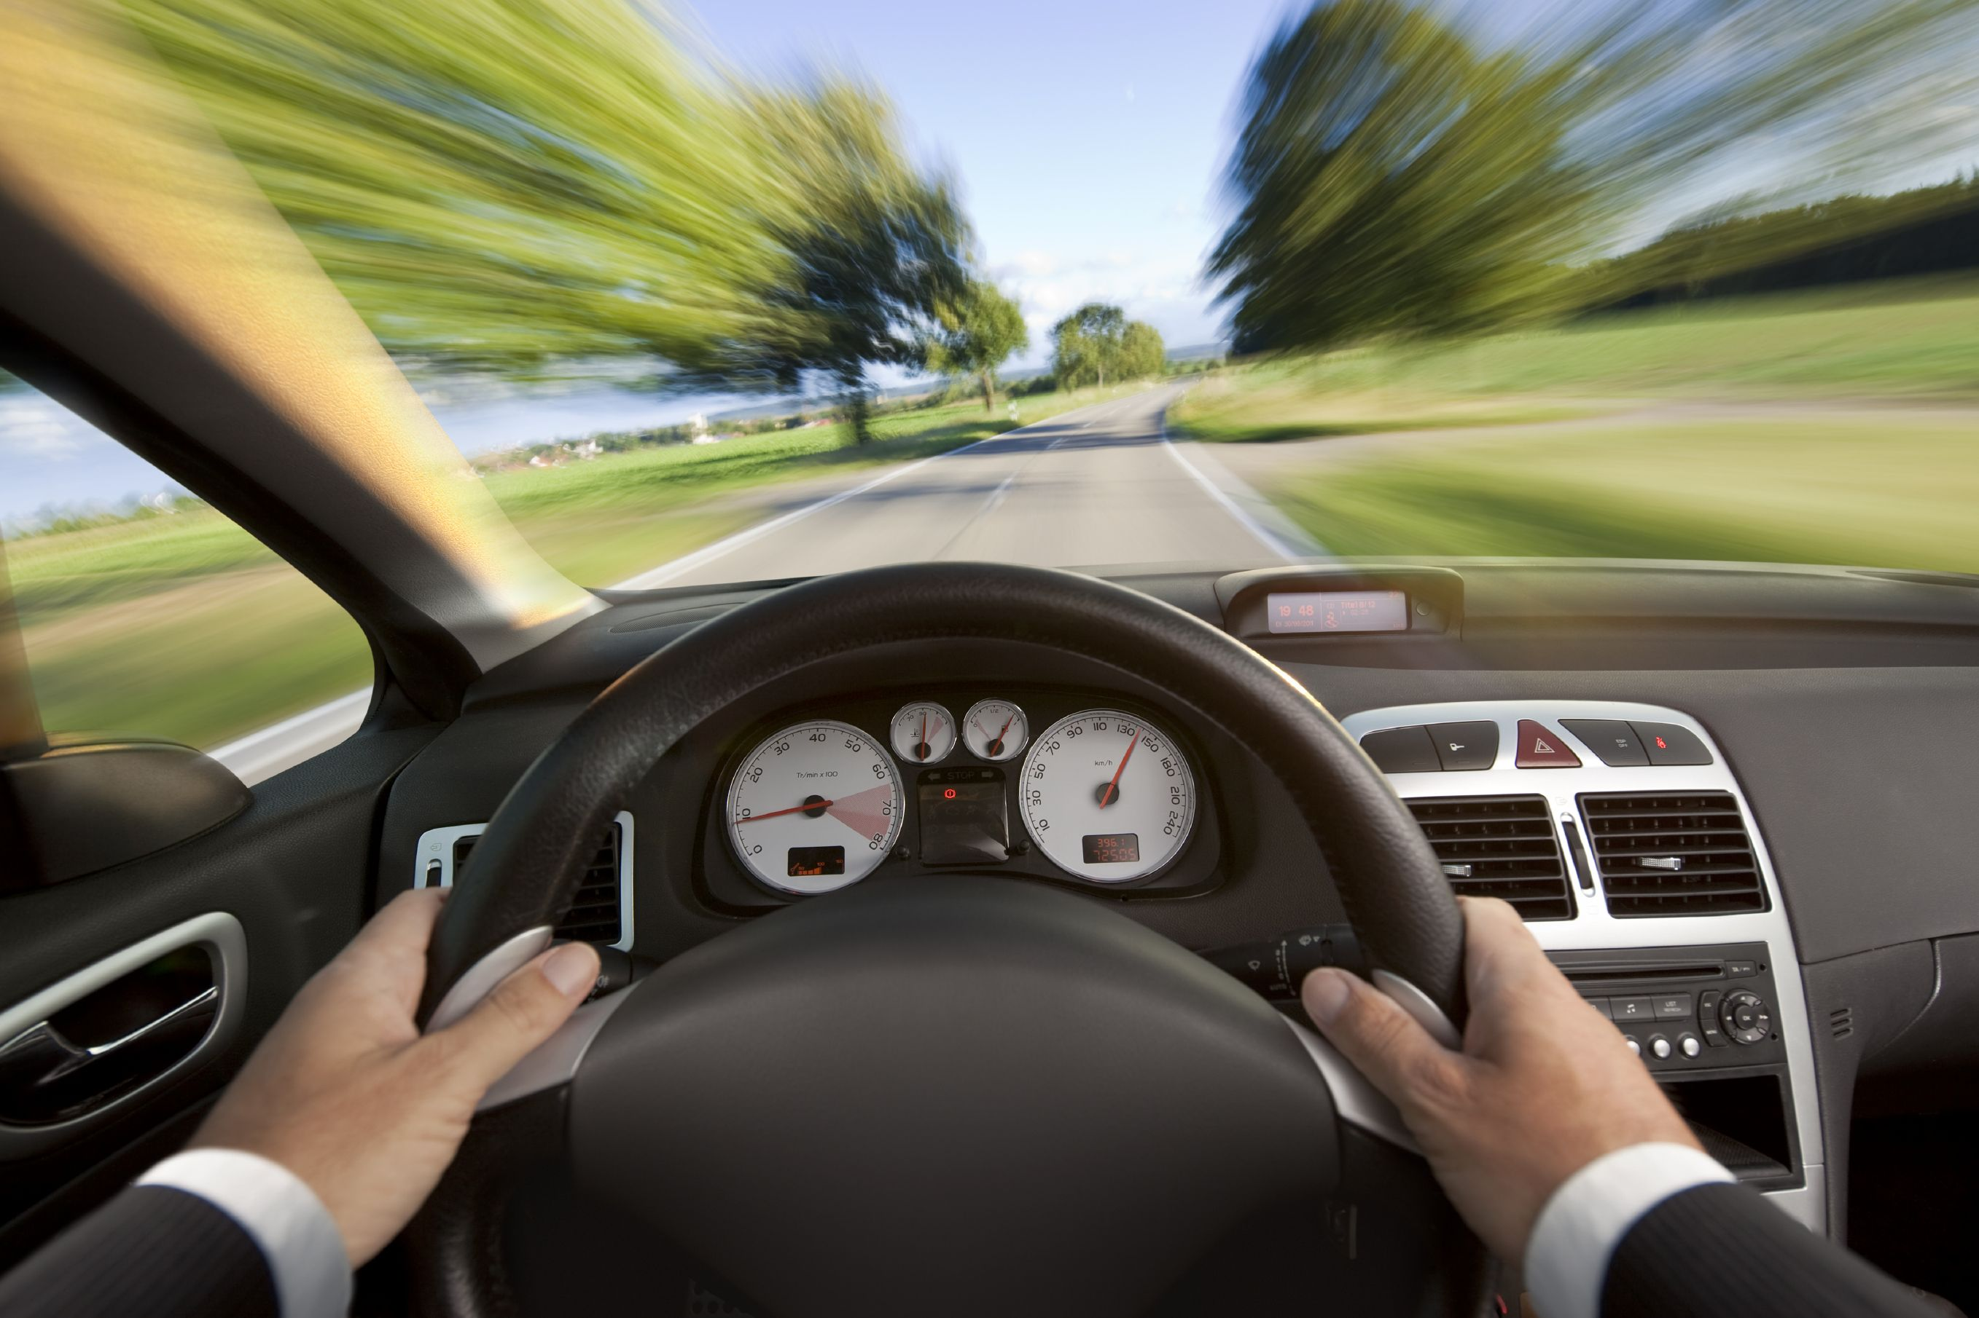
SPEEDING
YCSO will start a speed study to get results of when the highest volume of traffic is present.
If YCSO detects speeding in the 85th percentile they will place speed alert signs up (typically for a week).
YCSO will begin enforcement efforts if they see no change in patterns.

Slide 21
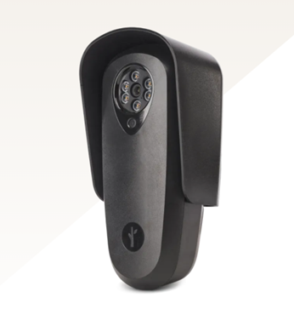
NEIGHBORHOOD WATCH
*UPDATE* Flock Safety Sparrow Automatic License Plate Recognition (ALPR) Camera
Self contained - Can be installed anywhere
Company maintains and services the camera for an annual subscription price of $2,400/unit per year (plus a one-time installation cost of $350 per camera).
Provides vehicle “Fingerprint” technology. Footage provides ability to provide:
  Timestamp
  Vehicle Make and Color
  License plate
  Number of visits
Software compatible with software installed in York County patrol cars.
Recommended by York County Sherriff Montgomery
County cost-sharing programs are currently paused, our focus is to stay “grant ready.”

Slide 22
ARCHITECTURE CONTROL COMMITTEE
Sam Huffstetler
Director

Slide 23
Committee Members
ARCHITECTURE CONTROL
Kyle Aulenbach
James Wright
Breana Schaefer
Vacant

Slide 24
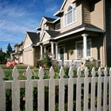
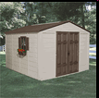

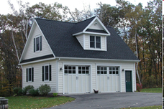
Running Man ACC
ARCHITECTURE CONTROL
Architecture Control Committee (ACC) focuses on additions or external modifications to the property
Contact the ACC Chair if you have questions about your project before you begin your project.

Slide 25
ACC Submissions
ARCHITECTURE CONTROL
The ACC Change Request form can be obtained on the RMCA website, then the HOA link.
Email, call, or text the ACC Director for submission process for quickest response.
Please include pictures that show the location of the addition, your plat, as well as a detailed description of the project, and check for the $25 fee made payable to RMCA.

Slide 26
ACC Notes of Interest
ARCHITECTURE CONTROL
35 Inquiries / Requests processed in 2025, up from 28 in 2024
13 Disclosure Packets
Current ACC Standards were published in 2023. ACC Committee recently reviewed the Standards and will present it to the HOA Board in January for review and approval. Changes proposed include:
  All freshly painted surface must cover old paint
  Prohibiting Portable Car Cover that sit on the ground or are attached to a structure
Protection Area (RPA) or a Resource Management Area (RMA) and may slightly vary the ACC Standards, which is why it is important to check with the ACC before any work begins on your project for approval.

Slide 27
Running Man Standards
ARCHITECTURE CONTROL
Not necessarily specific to Architectural items
Defines
  Repair – replacing existing with same color, material, and size – ACC approval not required
  Replace – same feature, however, new material or color – ACC approval is required
  New – a permanent fixed structure not existing before – ACC approval is required
Offers specifics to help homeowners draft plans for certain elements
Maintenance reminder for certain expectations that do not require ACC approval – free of mold, roofs and gutters free of debris, etc.

Slide 28
Seeking new ACC Committee Member
ARCHITECTURE CONTROL
Member Requirements
Review submitted ACC Change Requests for consistency with published Standards
  Committee receives on average 1 ACC Change Request every 10 days
  Recommend any needed changes to the Standards to the ACC Director for consideration
Serving on the ACC Committee offer the opportunity to support the community without a heavy investment of time.

Slide 29
COVENANTS
Ritendra Bhattacharya
Director

Slide 30
COVENANTS
Covenants’ purpose
  Maintain property values and minimize annoyance, distraction or offensive property use
Board’s current covenants philosophy
  Pragmatic enforcement of clear-cut covenants violations mixed with polite engagement on less-clear issues
What I *DON’T* do
  Drive around specifically looking for violations
  Walk onto your property to inspect something
What I *DO* do
  Respond to complaints I’ve received from Running Man residents (~10 this year)
  Most common infractions: Signs, trailers, boats and RVs in driveways
  Engage residents on issues I happen to notice while traversing the neighborhood

Slide 31
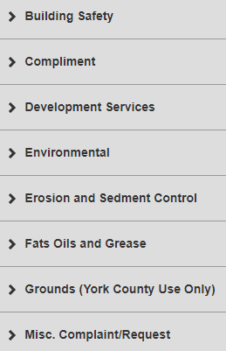
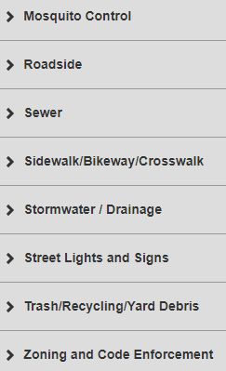
COVENANTS
York County Customer Service Requests
https://yorkips.yorkcounty.cloud/
See list
York-Poquoson Sheriff’s Non-Emergency No. 757-890-3621

Slide 32
LANDSCAPE/COMMON AREAS
Matt Matson
Director

Slide 33
Duties of the Landscape Director
Attend Board of Directors monthly meetings
Monitor contractors
Routinely Inspect landscaping through-out Running Man Neighborhood
Recommend improvements
Oversee new plantings, signs, entrance lighting and brick walls
Provide assistance to the board and members
Operate within the budget

Slide 34
2025 Year-End Review
Expanded Main Playground
Removed and Installed New Split Rail Fencing
Entrance Signs (In progress)
Overhaul Chaptico and Pungo Walking Paths

Slide 35
2026 Goals
Mulch Playgrounds
Overhaul Big Bethel Landscape
Potential County Easement on Powerlines
Remove Overhanging Brush/Trees Around Entrance Signs

Slide 36
SUMMARY
Eric Todhunter
President

Slide 37
Running Man HOA Board 2025 Summary of Actions Overview
Completed new Reserve Study
Updated Easement in contract with Dominion Energy to facilitate DISH work
Expanded the main playground near the clubhouse
Overhauled Chaptico and Pungo Walking Paths
Replace the fence near main playground
Contracted to clean Retention Pond forebays
Contracted to replace the “Running Man” signs on entry monuments

Slide 38
Running Man HOA Board 2026 Goals
Revitalize socialization and restart voting process on new proposed neighborhood governing documents
Re-dredge retention pond forebays on Victory side of RM Trail
Complete work on Running Man signage for entry monuments
Repair Big Bethel foliage retention walls and update landscaping
Remove overhanging brush/trees around Entrance Signs
Explore shade options for main playground area
Explore new information sign options for the neighborhood
Explore new shelter options near main playground
Explore new camera options for neighborhood entries

Slide 39
Christmas Luminaries
Need Volunteers to:
  Pack and Deliver at the Clubhouse 1PM, Wednesday, Dec 17th
  Put candles out in Common Areas Dec 24th
  Pick up candles from Common Areas Dec 25th
Sand Delivery Friday, Dec 12th
Luminaries Inclement weather decision will be posted on the Next Door Neighbor App and Running Man website.
If you’re not going to be home, need help, or are able to volunteer please notify Bonnie Todhunter via text or call @ (757)532-2323.

Slide 40
ELECTION OF OFFICERS
Current Nominees
Nominations from the Neighborhood – If you’re interested in joining the CY2026 RM HOA Board please let us know.
Vote
Ritendra Bhattacharya
David Glover
Sam Huffsteler
Russell Kratoville
Matt Matson
Liz Rooney
Eric Todhunter
Noel West

Slide 41
Thanks for Your Support
and
Happy Holidays
from the
Running Man Community Association Board

